Slide 1


Graphics
Images within 2D games
Part 4 – Animation

Slide 2

Animations

Slide 3



: Image Sequences
An image sequence is simply a series of images, displayed one after the other. If the playback is fast a series of progressive images will appear as continuous, unbroken animation.
Query: How many frame/s are needed to give the appearance of unbroken animation?
A – 50 frame/s
B – 30 frame/s
C – 20 frame/s
D – 10 frame/s
E – 5 frame/s

Slide 4

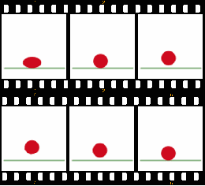
: Image Sequences
TV and film is often shot at either 24, 25 or 30 frames/second (the current high-end is 48 fps)
Consider the set of 6 images:
At 2 frame/s it is not smooth
At 10 frame/s it is reasonably smooth
A typical animated cartoon run at 12 frame/s

Slide 5

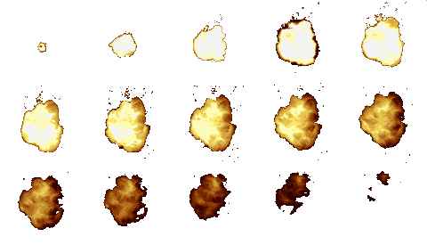
: Sequence Source
Images to be played back as a sequence may reside within a number of different file structures, including:
A series of files (1 image per file)
A continuous image strip (1 file)
An image sheet (1 file)
Aside: For best performance, all images should be stored in an image sheet, with all animations using that sheet rendered together.

Slide 6
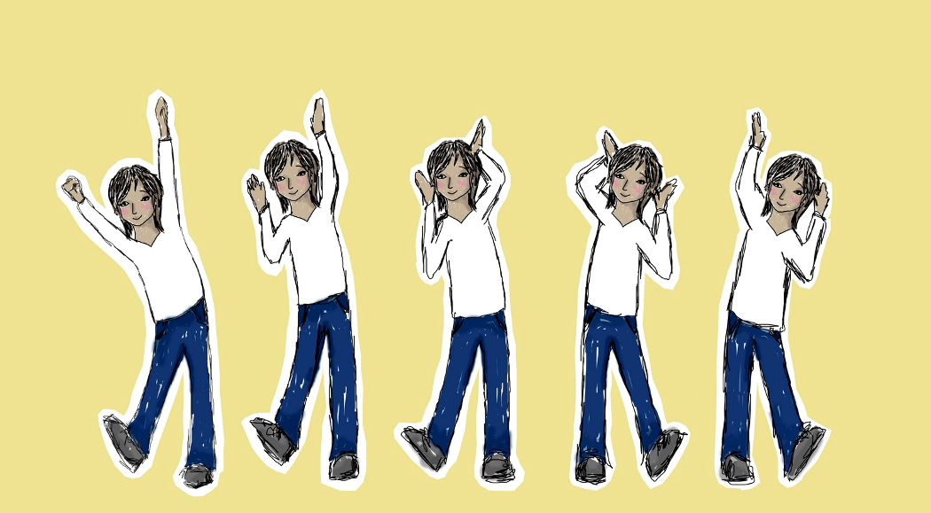
Image Sequence Playback

Slide 7

Playback of an image sequence can be integrated into the update/draw loop as follows:
During the update phase determine when the next image in the sequence should be selected to provide the target number of frames/second
During the draw phase, render the current selected image

Slide 8
Assuming the images are stored as an array (or an array of rectangles into a single image sheet) the following parameters can be used to offer different playback options:
playCount- number of times to play the animation (-1 = loop forever, 0 = pause)
homeFrame – frame to display when not animating
currentFrame – current frame to display
animationPeriod – number of ms which a single playback should take
startTime – start time of the animation (if playback has commenced)
1 | private Image[] images;
2
3 | private int playCount;
4 | private int homeFrame;
5 | private int currentFrame;
6 | private int animationPeriod;
7 | private int startTime;

Slide 9

The update() method determines the current frame that should be displayed in the animation. In turn the draw() method simply draws the current frame.
1 | public void update() {
2 | determineCurrentFrame();
3 | },
4
5 | public void draw(Graphics graphics2D,
6 | int drawX, int drawY) {
7 | graphics2D.drawBitmap(
8 | images[currentFrame], drawX, drawY);
9 | };

Slide 10
1 | public int determineCurrentFrame() {
2
3 | long currentTime = GetCurrentTime();
4 | if (startTime == -1)
5 | startTime = currentTime;
6
7 | if (playCount > 0)
8 | if (currentTime - startTime
9 | > (long) playCount * animationPeriod)
10 | playCount = 0;
11
12 | if (playCount == 0) {
13 | currentFrame = homeFrame;
14 | } else {
15 | long timeIntoAniminationPeriod =
16 | (currentTime – startTime) % animationPeriod;
17 | currentFrame = (int) (
18 | (timeIntoAniminationPeriod * (long)images.length )
19 | / animationPeriod );
20 | }
21 | return currentFrame;
22 | }
The start time will be reset to -1 anytime the play count is changed.
A check is made to see if the animation has completed, in which case the playCount is reset to zero.
Based on the current time, target animation period and playCount value the current frame is calculated and returned.

Slide 11

Key takeaways:
Animation is nothing more than the timed display of images within a sequence – our brains do the rest.
You might need to do a bit of work to load/separate the sources images within each animation.

